Slide 1
All you have to know
about Wi-Fi and radiation
172040141
劳启中

Slide 2

Wi-Fi is everywhere
Wi-Fi makes life easier
Invisible radio waves through our space and body.
What effect all that wireless energy might have

Slide 3
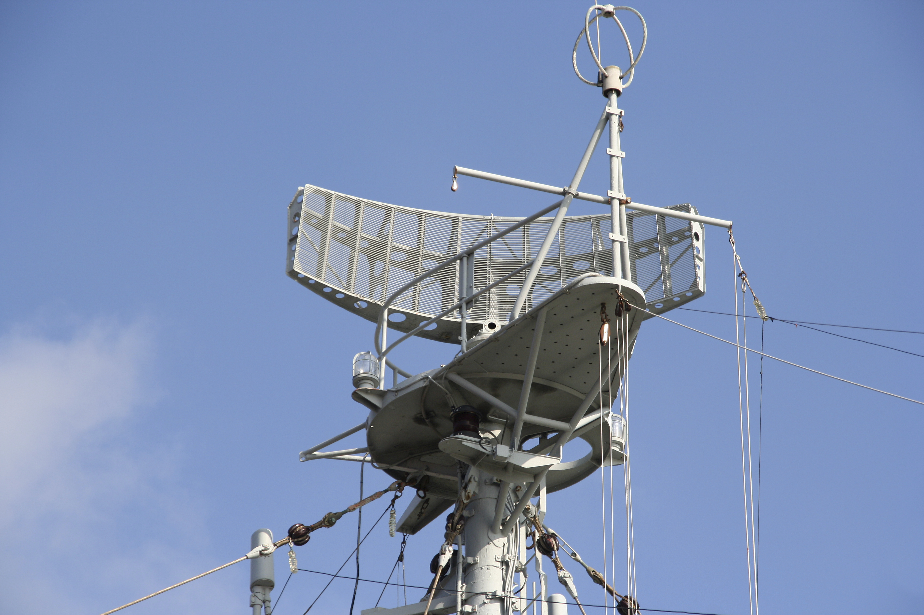

Research on Wi-Fi
The research goes back at least to the 1950s
Radiation promote cancer in high frequency
Skin burns , not cancer in terms of low frequency

Slide 4
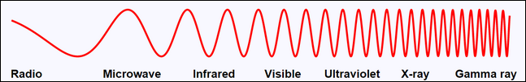
Not All Radiation Is Equal
Ionizing and non-ionizing radiation
Long wavelengths and short wavelength

Slide 5
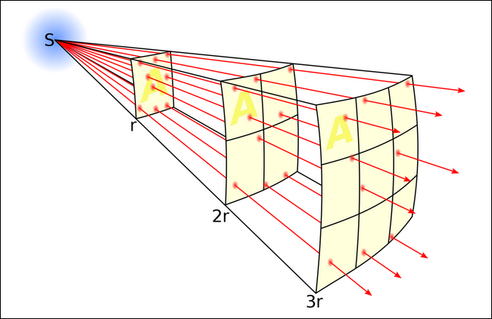
Distance and Power Matter
Powerful at a very close range
Shorter distance , higher power
Inverse-square law.

Slide 6
THANK YOU FOR WATCHING

